Slide 1


Azərbaycan Dövlət Neft və Sənaye Universiteti
Calculus
Single Variable

Slide 2
Application of Differentiation:
Newton’s Method

Slide 3
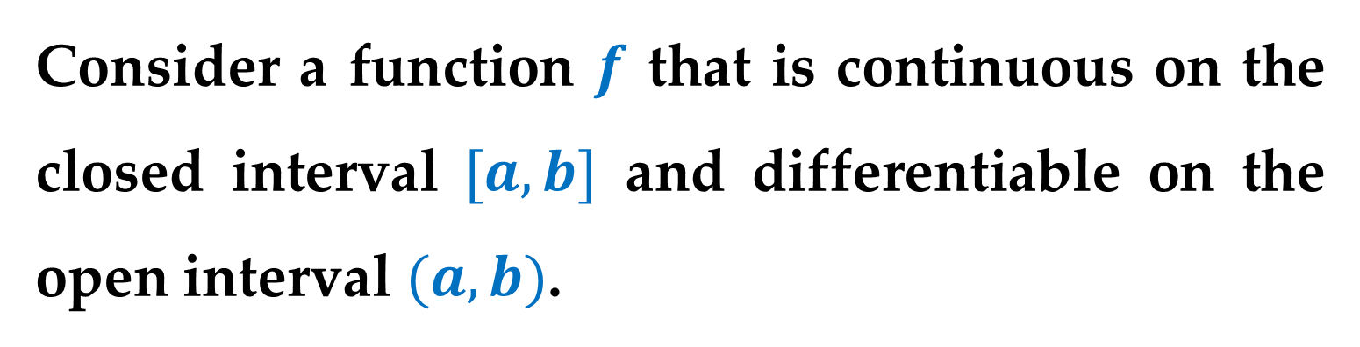
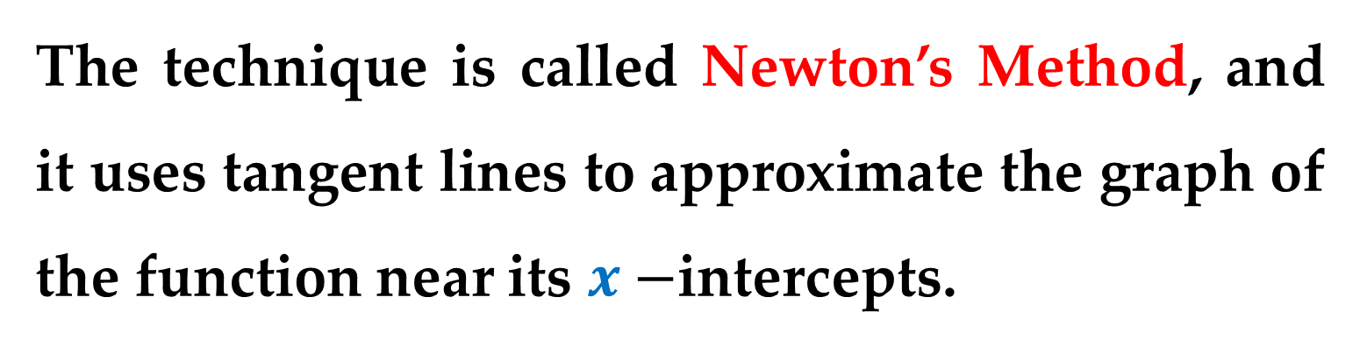
In this lecture you will study a technique for approximating the real zeros of a function.
The technique is called Newton’s Method, and it uses tangent lines to approximate the graph of the function near its $x−$intercepts.
Consider a function $f$ that is continuous on the closed interval $[a,b]$ and differentiable on the open interval $(a,b)$.

Slide 4

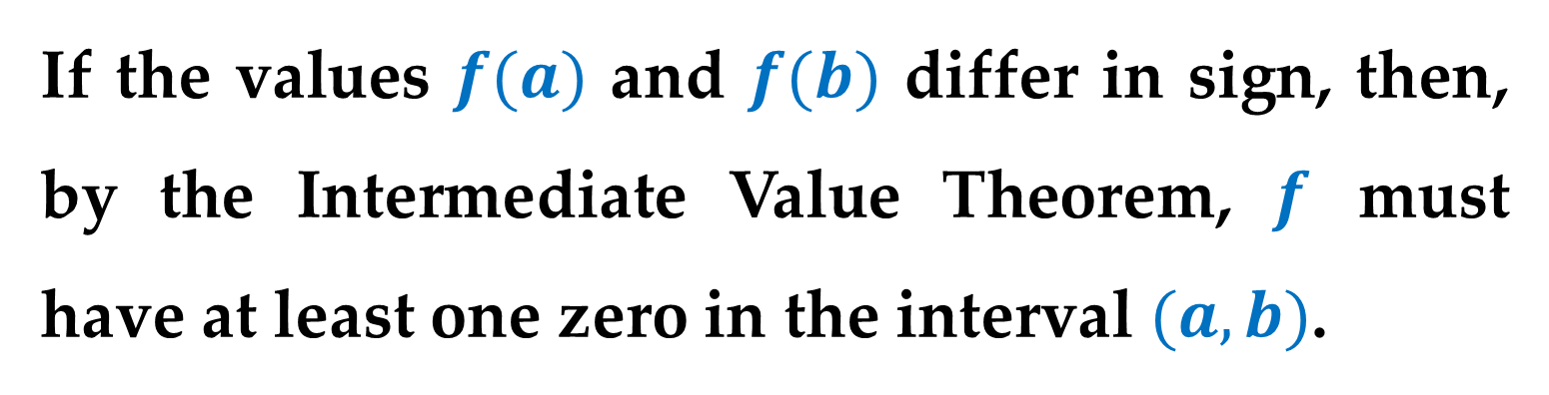
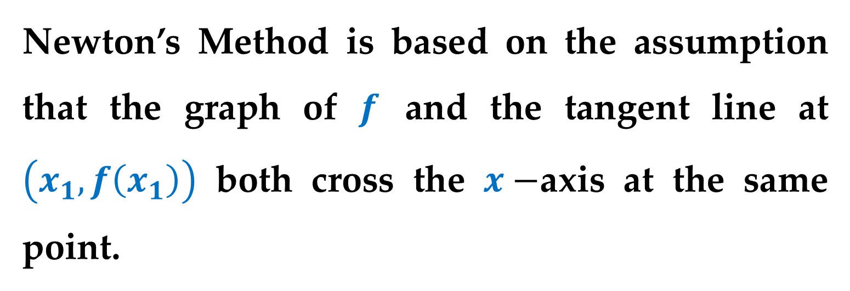
If the values $f(a)$ and $f(b)$ differ in sign, then, by the Intermediate Value Theorem, $f$ must have at least one zero in the interval $(a,b)$.
Suppose you estimate this zero to occur at
$x=x_{1}$ First estimate
Newton’s Method is based on the assumption that the graph of $f$ and the tangent line at $\left(x_{1},f\left(x_{1}\right)\right)$ both cross the $x−$axis at the same point.

Slide 5
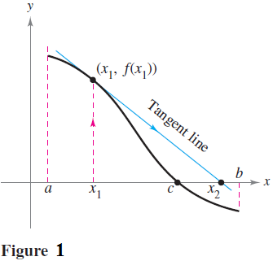
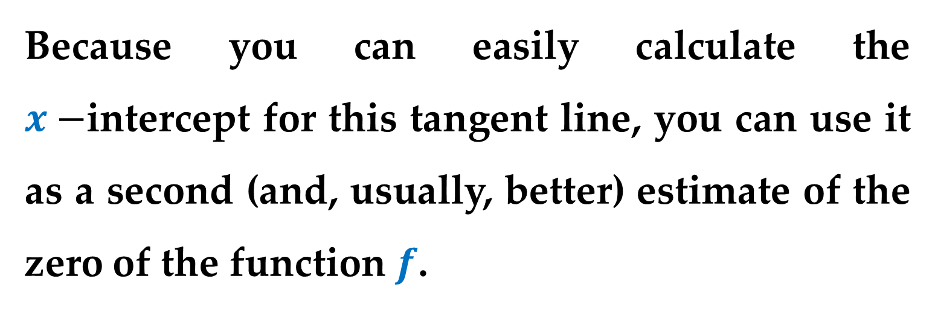
Because you can easily calculate the $x−$intercept for this tangent line, you can use it as a second (and, usually, better) estimate of the zero of the function $f$.

Slide 6
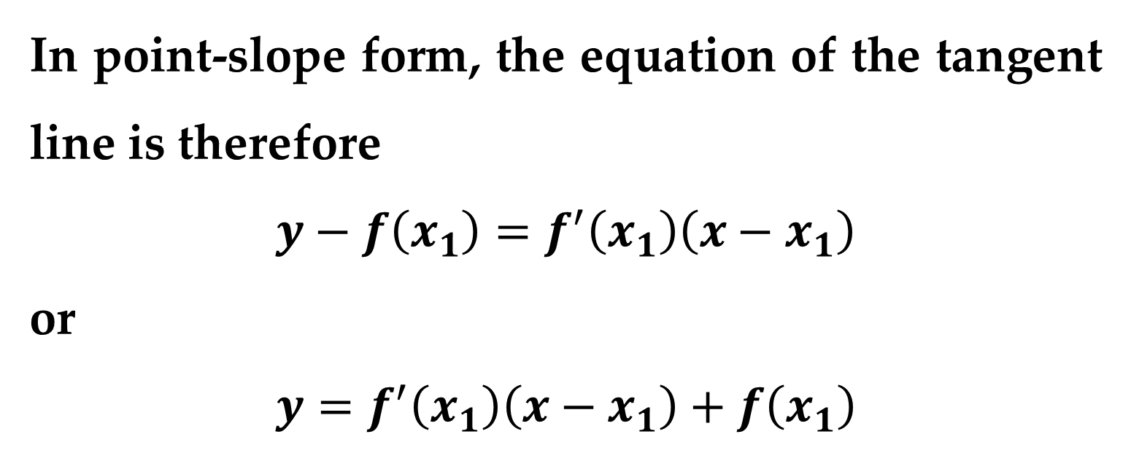
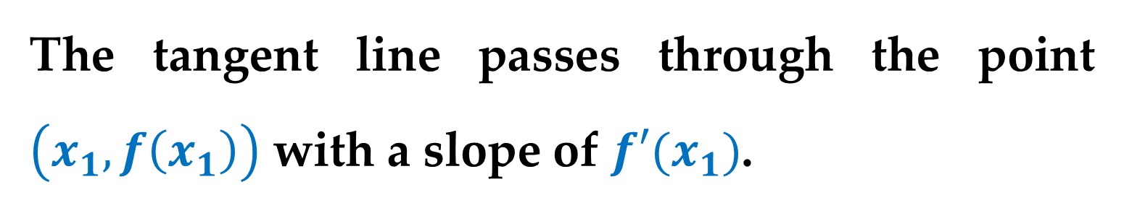
The tangent line passes through the point $\left(x_{1},f\left(x_{1}\right)\right)$ with a slope of $f′(x_{1})$.
In point-slope form, the equation of the tangent line is therefore
$$y−f\left(x_{1}\right)=f^{′}\left(x_{1}\right)\left(x−x_{1}\right)$$
or
$$y=f^{′}\left(x_{1}\right)\left(x−x_{1}\right)+f\left(x_{1}\right)$$

Slide 7
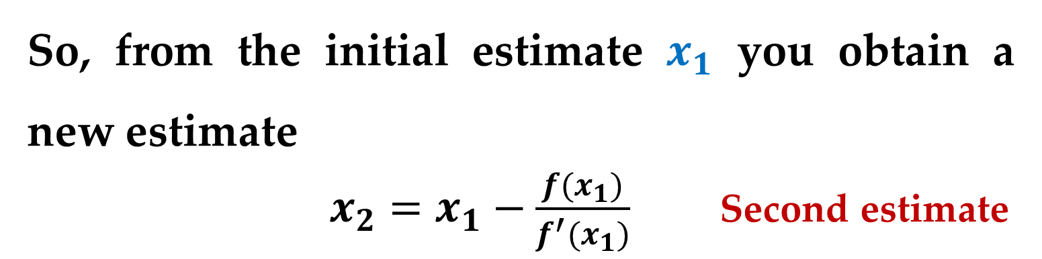

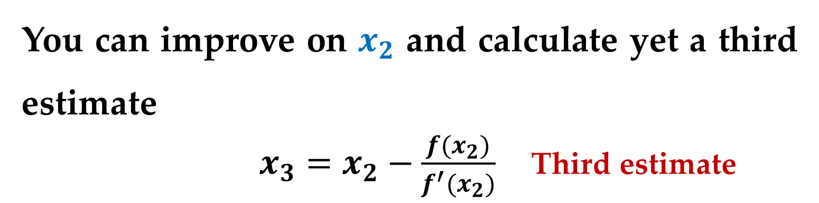
Letting $y=0$ and solving for $x$ produces
$x=x_{1}−\frac{f(x_{1})}{f^{′}(x_{1})}$
So, from the initial estimate $x_{1}$ you obtain a new estimate
$x_{2}=x_{1}−\frac{f(x_{1})}{f^{′}(x_{1})}$ Second estimate
You can improve on $x_{2}$ and calculate yet a third estimate
$x_{3}=x_{2}−\frac{f(x_{2})}{f^{′}(x_{2})}$ Third estimate

Slide 8
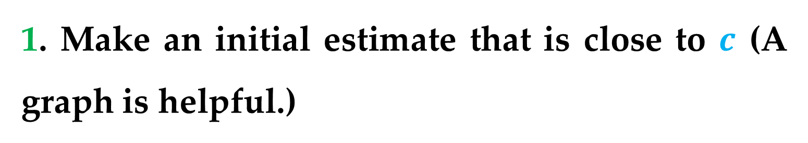
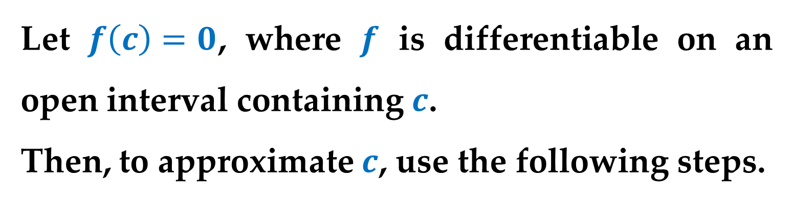
Repeated application of this process is called Newton’s Method.
Approximating the Zeros of a Function
Let $f\left(c\right)=0$, where $f$ is differentiable on an open interval containing $c$.
Then, to approximate $c$, use the following steps.
1. Make an initial estimate that is close to $c$ (A graph is helpful.)

Slide 9
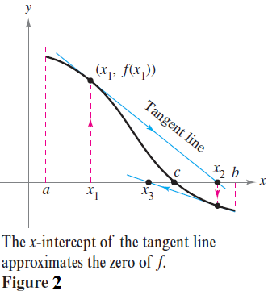
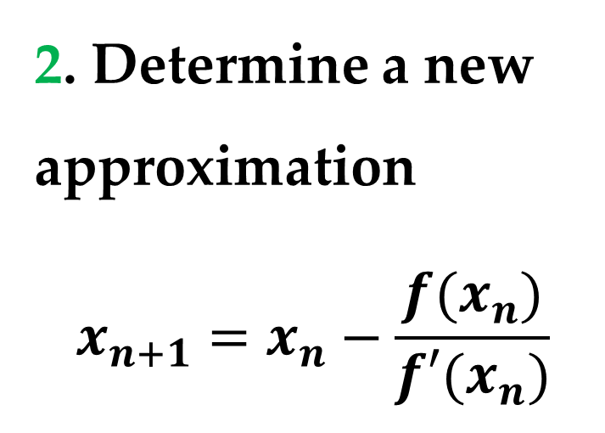
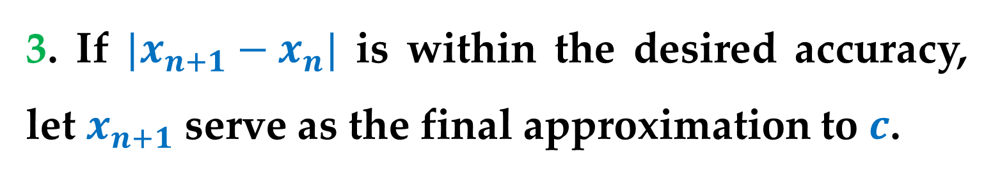
Approximating the Zeros of a Function
2. Determine a new approximation
$$x_{n+1}=x_{n}−\frac{f(x_{n})}{f′(x_{n})}$$
3. If $|x_{n+1}−x_{n}|$ is within the desired accuracy, let $x_{n+1}$ serve as the final approximation to $c$.

Slide 10
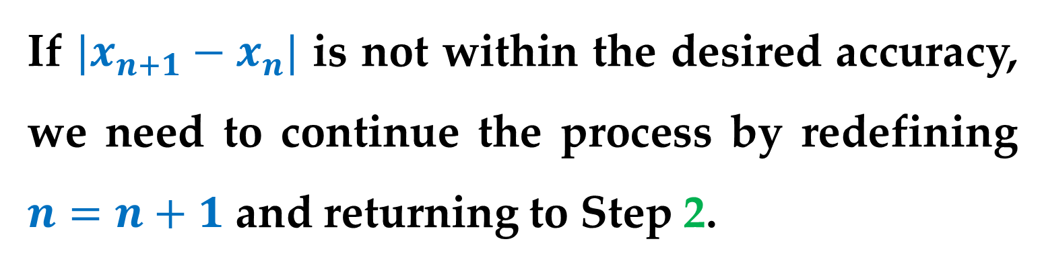
Approximating the Zeros of a Function
If $|x_{n+1}−x_{n}|$ is not within the desired accuracy, we need to continue the process by redefining $n=n+1$ and returning to Step 2.
Each successive application of this procedure is called an iteration.

Slide 11
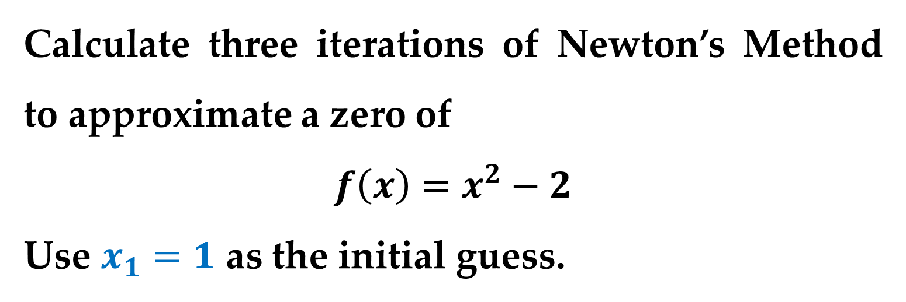
Example 1. Using Newton’s Method
Calculate three iterations of Newton’s Method to approximate a zero of
$$f\left(x\right)=x^{2}−2$$
Use $x_{1}=1$ as the initial guess.

Slide 12
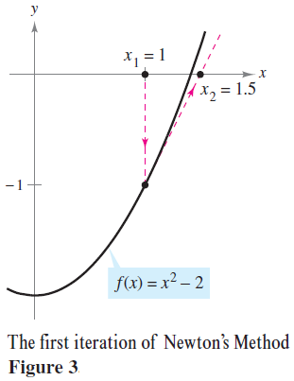
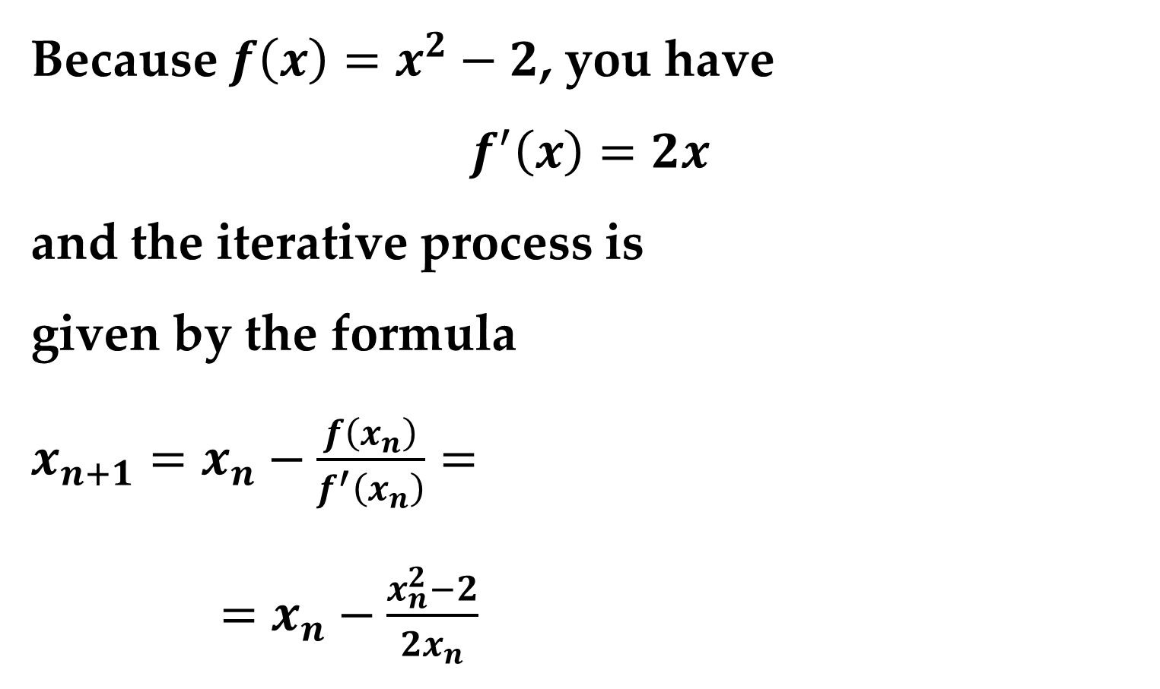
Solution
Because $f\left(x\right)=x^{2}−2$, you have
$$f^{′}\left(x\right)=2x$$
and the iterative process is
given by the formula
$x_{n+1}=x_{n}−\frac{f\left(x_{n}\right)}{f^{′}\left(x_{n}\right)}=$
$=x_{n}−\frac{x_{n}^{2}−2}{2x_{n}}$

Slide 13
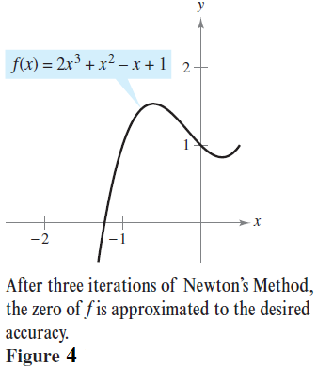
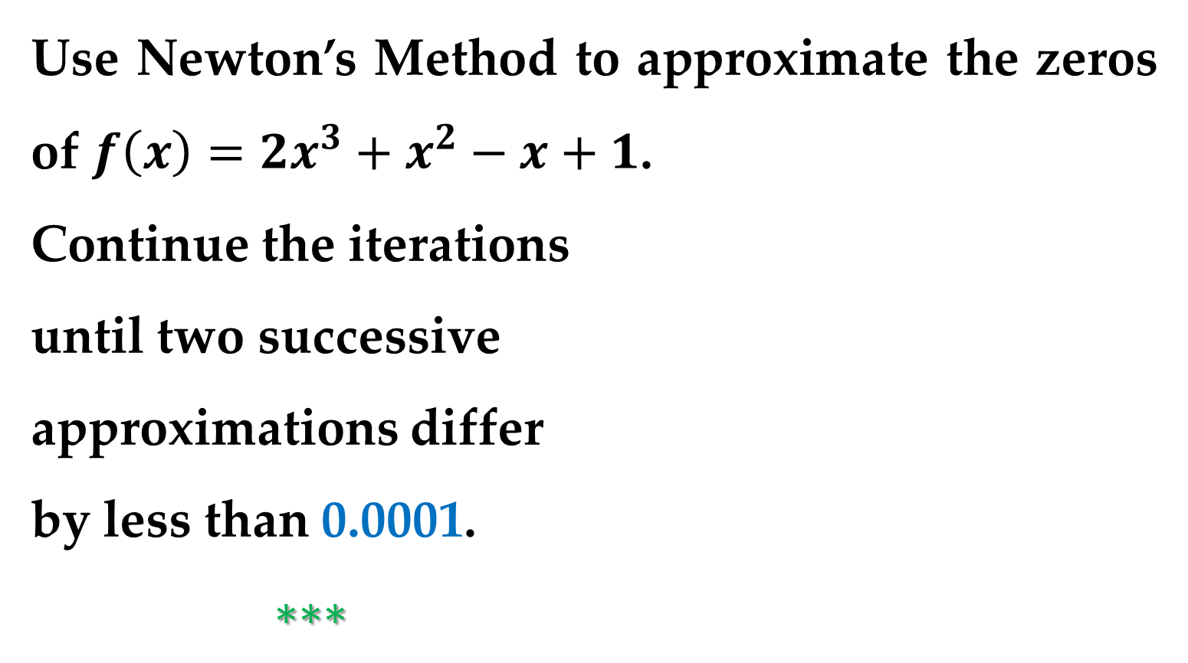
Example 2. Using Newton’s Method
Use Newton’s Method to approximate the zeros of $f\left(x\right)=2x^{3}+x^{2}−x+1$.
Continue the iterations
until two successive
approximations differ
by less than 0.0001.
$∗∗∗$

Slide 14

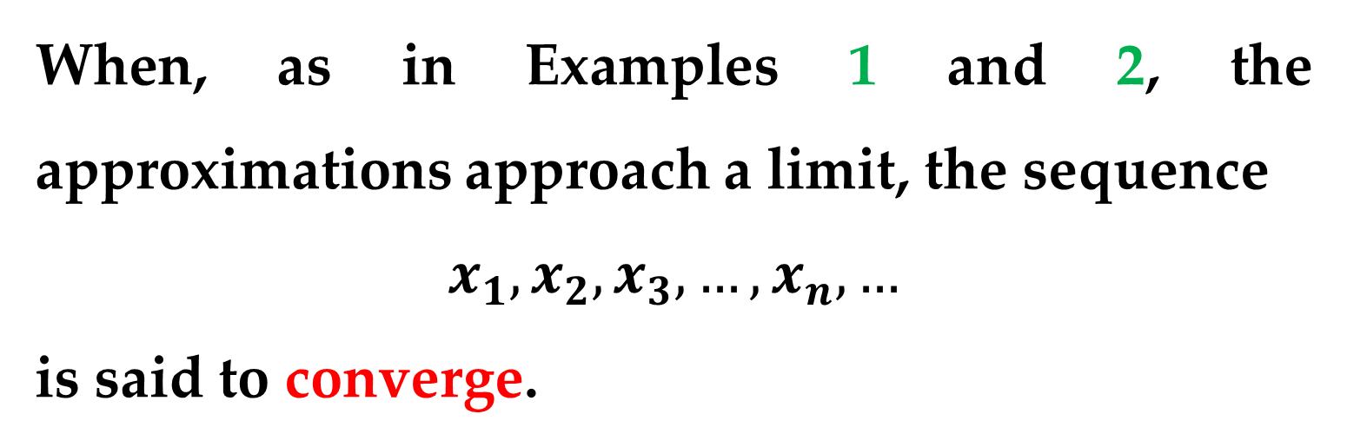
Remark
When, as in Examples 1 and 2, the approximations approach a limit, the sequence
$$x_{1},x_{2},x_{3},…,x_{n},…$$
is said to converge.
Moreover, if the limit is $c$, it can be shown that must be a zero of $f$.

Slide 15
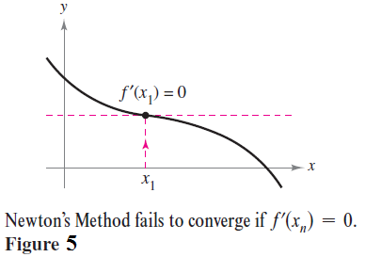
Remark
Newton’s Method does not always yield a convergent sequence.
One way it can fail to do so is shown in
Figure 5.

Slide 16
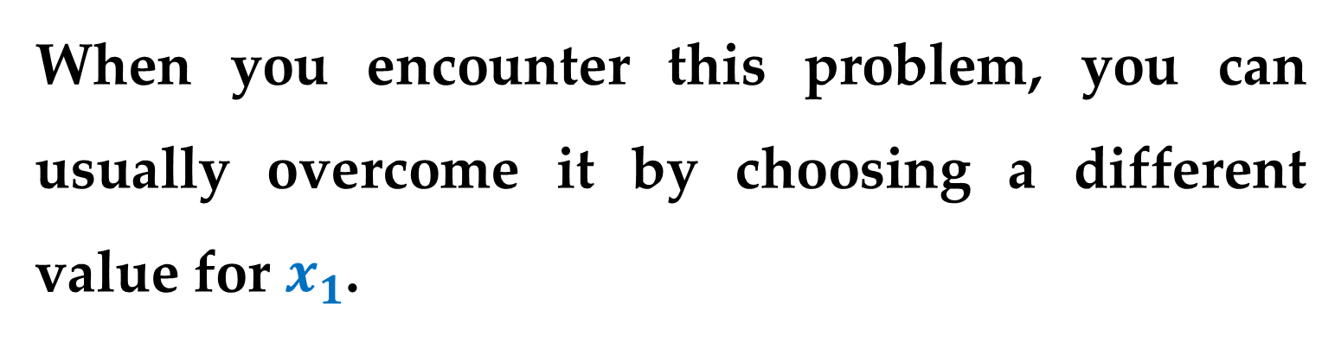
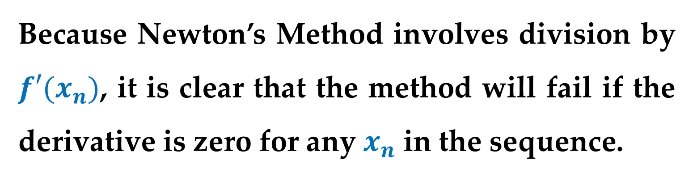
Because Newton’s Method involves division by $f′(x_{n})$, it is clear that the method will fail if the derivative is zero for any $x_{n}$ in the sequence.
When you encounter this problem, you can usually overcome it by choosing a different value for $x_{1}$.
Another way Newton’s Method can fail is shown in the next example.

Slide 17
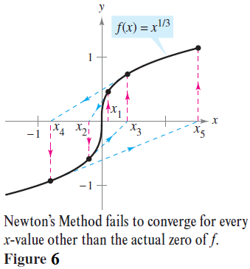
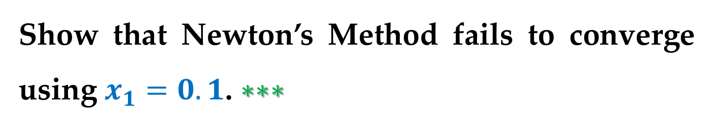
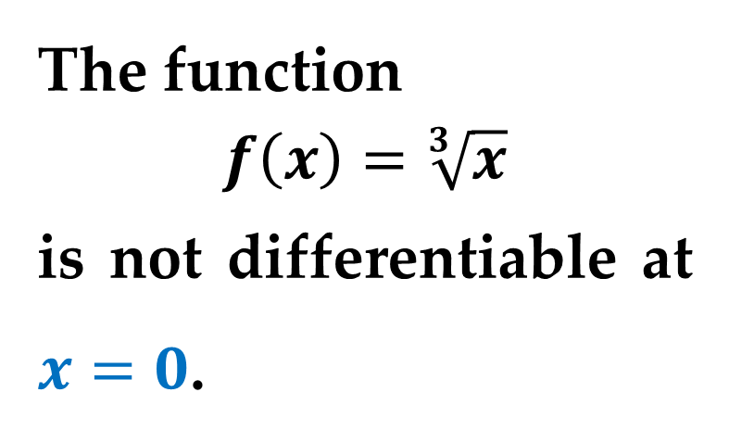
Example 3. An Example in Which Newton’s Method Fails
The function
$$f\left(x\right)=\sqrt[3]{x}$$
is not differentiable at $x=0$.
Show that Newton’s Method fails to converge using $x_{1}=0.1$. $∗∗∗$

Slide 18
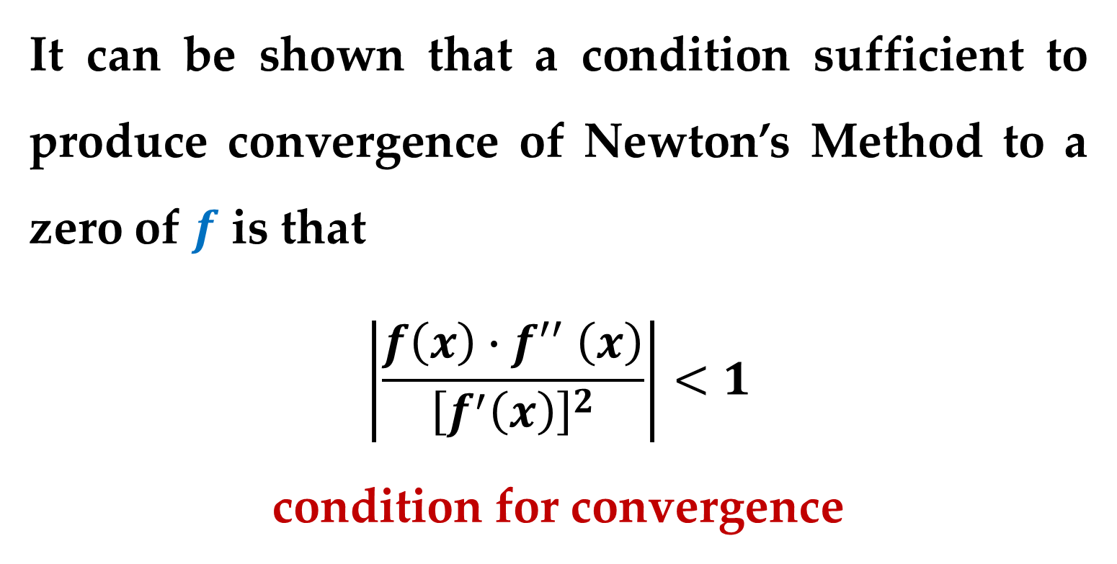
It can be shown that a condition sufficient to produce convergence of Newton’s Method to a zero of $f$ is that
$$\left|\frac{f\left(x\right){∙f}^{′′}\left(x\right)}{{\left[f^{′}\left(x\right)\right]}^{2}}\right|<1$$
condition for convergence
on an open interval containing the zero.

Slide 19
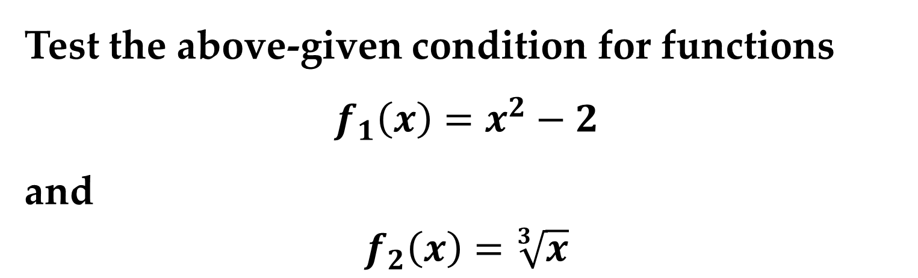
Task
Test the above-given condition for functions
$$f_{1}\left(x\right)=x^{2}−2$$
and
$$f_{2}\left(x\right)=\sqrt[3]{x}$$

Slide 20
Thank you for attention

